Slide 1
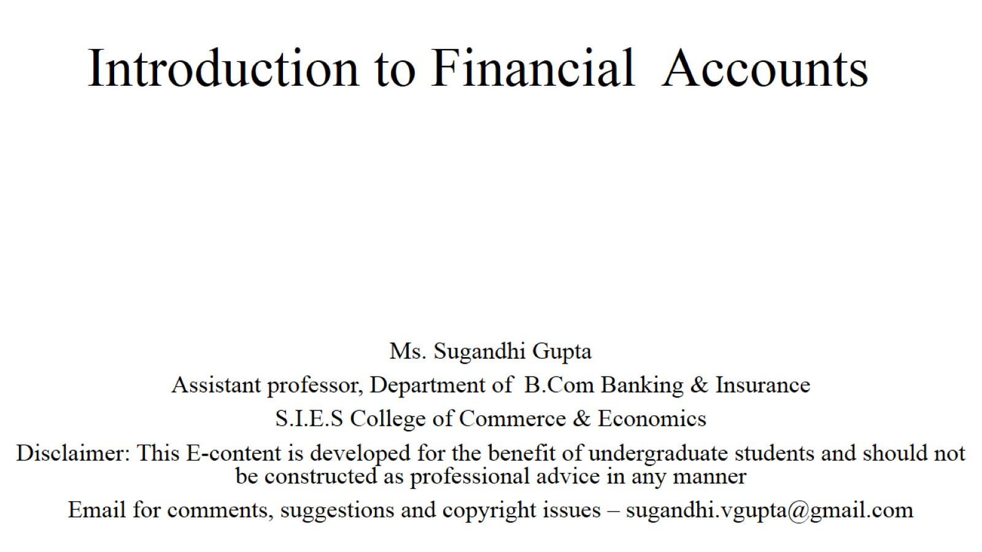
Introduction to Financial Accounts

Slide 2
Definition of Financial Accounts

Slide 3
Book Keeping Vs Accounting

Slide 5
Pro and Cons of Financial Accounts

Slide 8
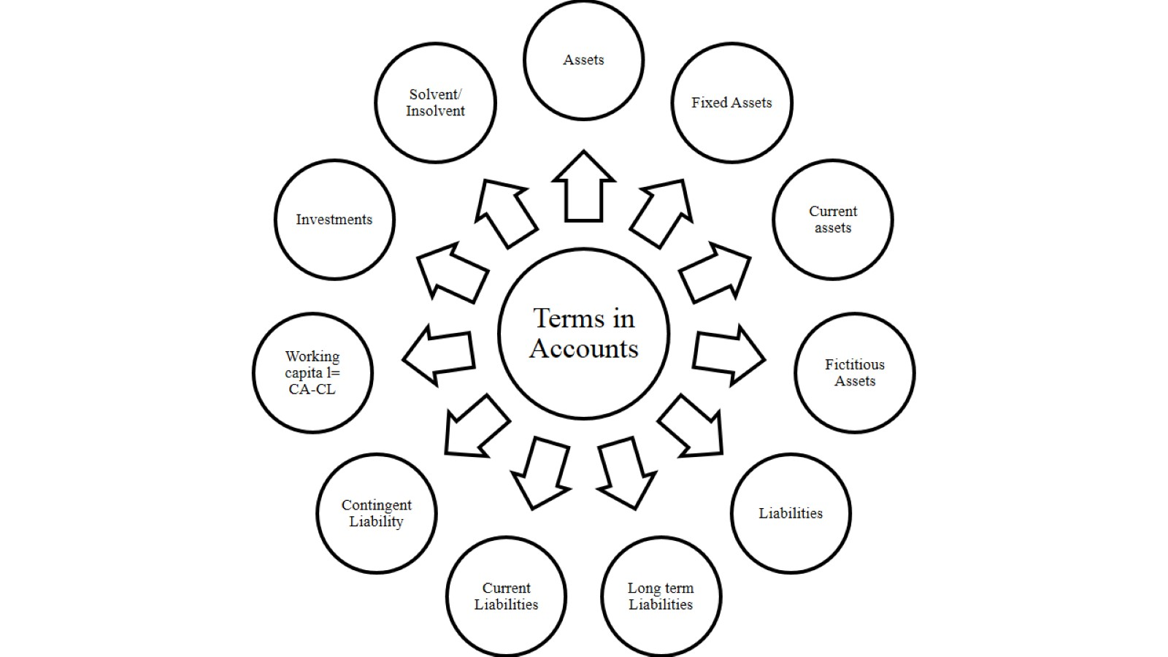

Slide 9
References

Slide 10
Thank You

